Slide 1
Chapter 9 Alkynes: An Introduction to Organic Synthesis

Slide 2
Learning Objectives
(9.1)
Naming alkynes
(9.2)
Preparation of alkynes: Elimination reactions of dihalides
(9.3)
Reactions of alkynes: Addition of HX and X₂
(9.4)
Hydration of alkynes

Slide 3
Learning Objectives
(9.5)
Reduction of alkynes
(9.6)
Oxidative cleavage of alkynes
(9.7)
Alkyne acidity: Formation of acetylide anions
(9.8)
Alkylation of acetylide anions
(9.9)
An introduction to organic synthesis

Slide 4

Alkynes
Hydrocarbons that contain carbon–carbon triple bonds
Acetylene is the simplest alkyne
Polyynes - Linear carbon chains of sp-hybridized carbon atoms
Notes:
Naming alkynes

Slide 5
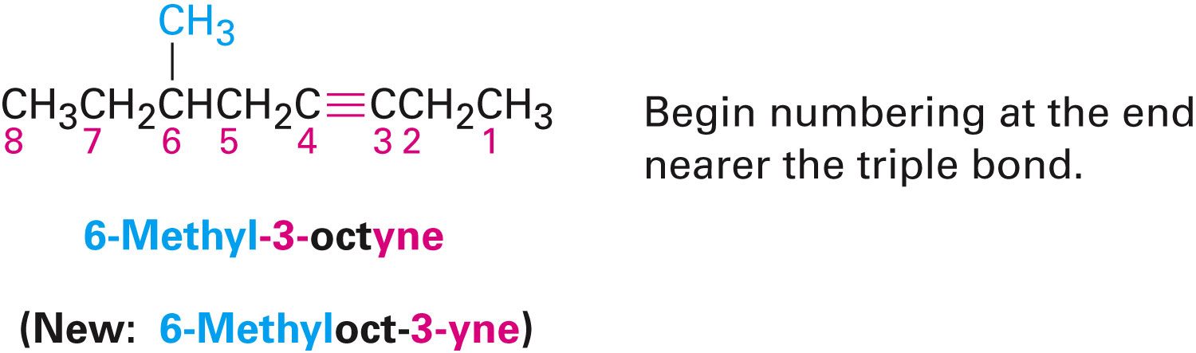
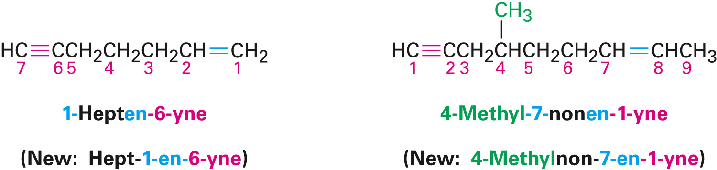
Naming Alkynes
General hydrocarbon rules apply
Suffix -yne indicates an alkyne
Number of the first alkyne carbon in the chain is used to indicate the position of the triple bond
Notes:
Naming alkynes

Slide 6
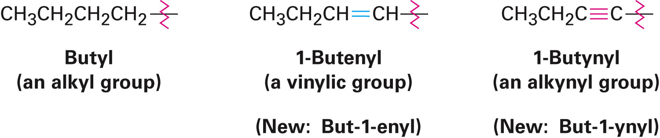
Naming Alkynes
Alkynyl groups are also possible
Notes:
Naming alkynes

Slide 7
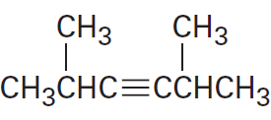
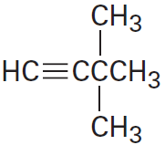
Worked Example
Name the following alkynes:
A)
B)
Notes:
Naming alkynes

Slide 8
Worked Example
Solution:
A) 2,5-Dimethyl-3-hexyne
B) 3,3-Dimethyl-1-butyne
Notes:
Naming alkynes

Slide 9
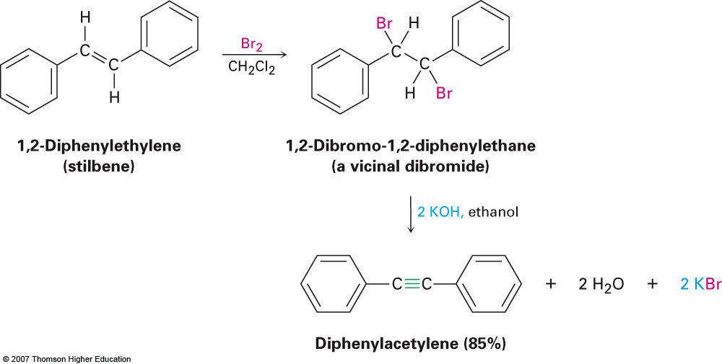
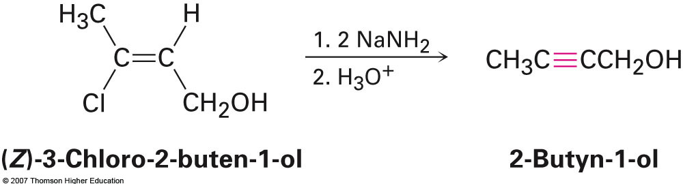
Preparation of Alkynes: Elimination Reactions of Dihalides
Treatment of a 1,2-dihaloalkane with KOH or NaOH produces a two-fold elimination of HX
Vicinal dihalides are available by addition of bromine or chlorine to an alkene
Intermediate is a vinyl halide
Notes:
Preparation of alkynes: Elimination reactions of dihalides

Slide 10
Reactions of Alkynes: Addition of HX and X₂
Carbon–carbon triple bond results from sp hybrid orbitals of carbon forming a σ bond and unhybridized 2p_{y} and 2p_{z} orbitals forming π bonds
Remaining sp orbitals form bonds to other atoms at 180°from the C–C bond
Acetylene is a linear molecule with H–C≡C bond angles of 180°
Breaking a π bond in acetylene (HCCH) requires 202 kJ/mole (in ethylene it is 269 kJ/mole)
Notes:
Reactions of alkynes: Addition of HX and X₂

Slide 11
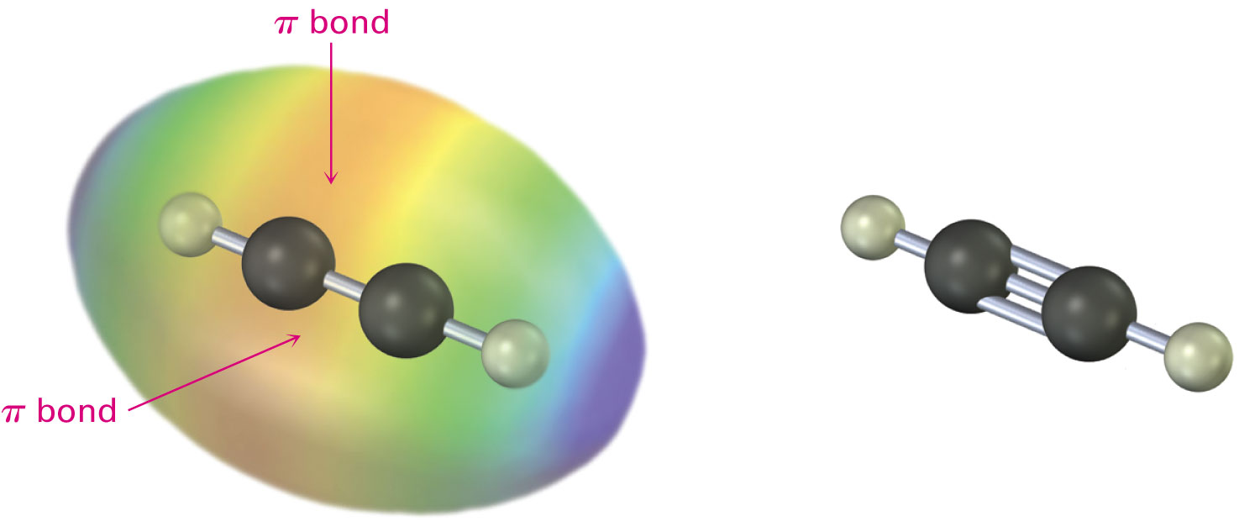
Figure 9.1 - Structure of Acetylene
Notes:
Reactions of alkynes: Addition of HX and X₂

Slide 12
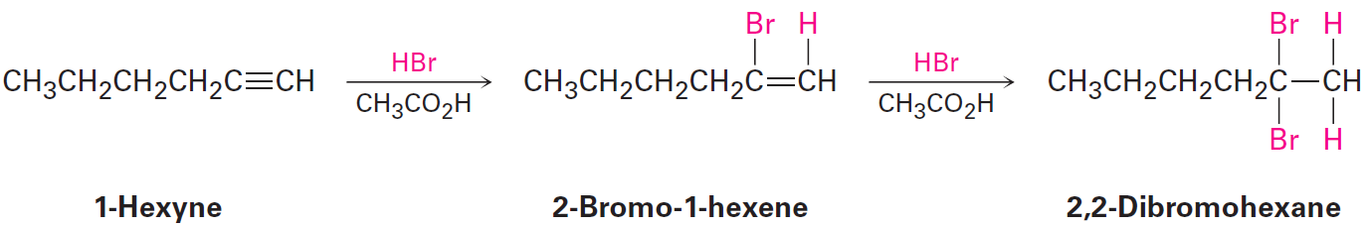
Reactions of Alkynes: Addition of HX and X₂
Addition reactions of electrophiles with alkynes are similar to those with alkenes
Regiochemistry according to Markovnikov’s rule
Notes:
Reactions of alkynes: Addition of HX and X₂

Slide 13
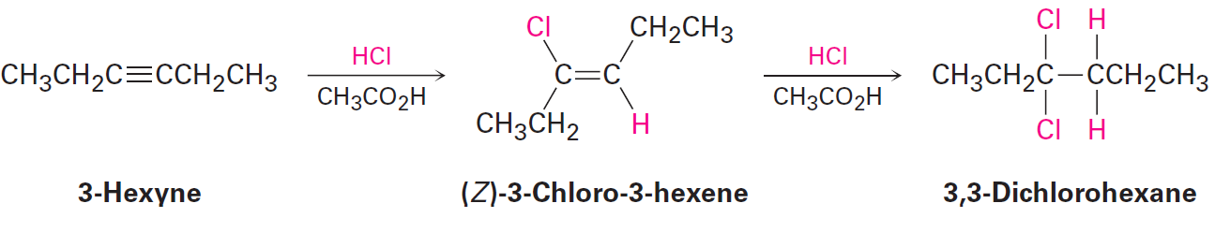
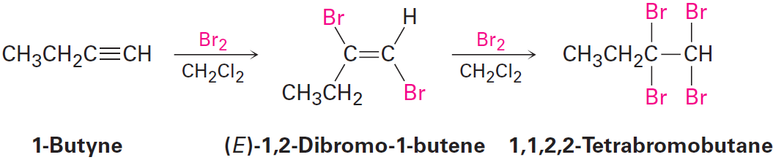
Reactions of Alkynes: Addition of HX and X₂
Addition products are formed when bromine and chlorine are added, resulting in trans stereochemistry
Notes:
Reactions of alkynes: Addition of HX and X₂

Slide 14
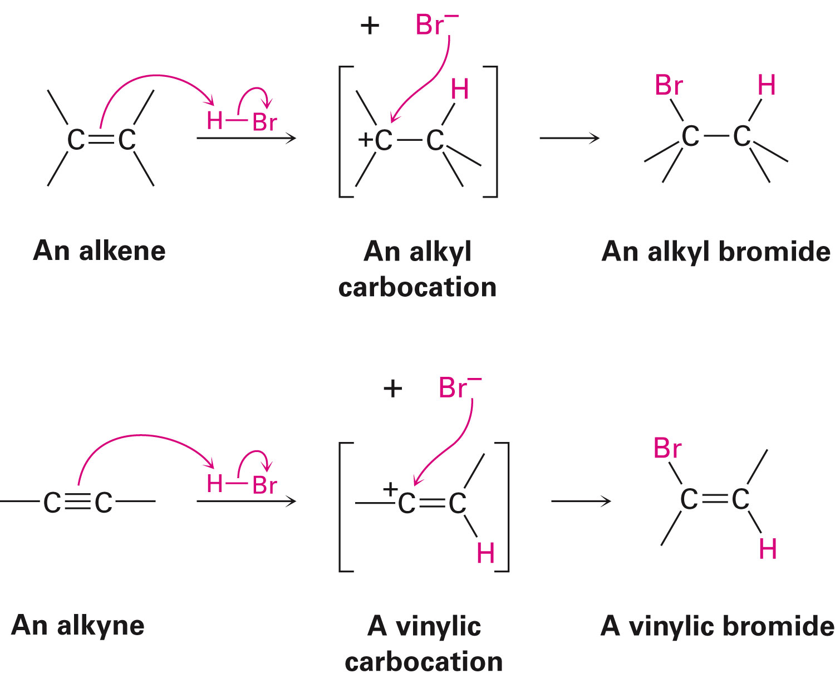
Similarities in Alkene and Alkyne Additions
Mechanisms of alkene and alkyne additions are similar but not identical
Addition of an alkene to an electrophile results is a two step process with an alkyl carbocation intermediate
Notes:
Reactions of alkynes: Addition of HX and X₂

Slide 15
Similarities in Alkene and Alkyne Additions
Replacing an alkene with an alkyne would result in the formation of an analogous vinylic carbocation as the intermediate
Notes:
Reactions of alkynes: Addition of HX and X₂

Slide 16
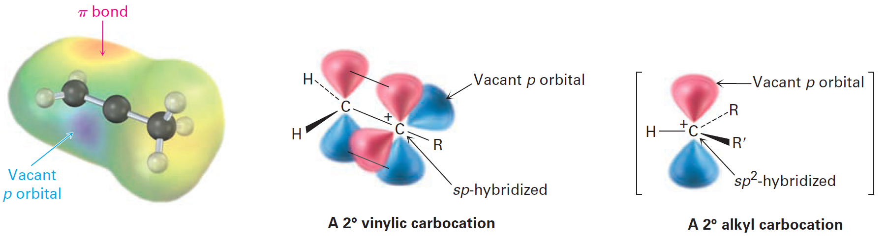
Figure 9.2 - Vinylic Carbocation
Comprises an sp-hybridized carbon and forms less readily than an alkyl carbocation
Notes:
Reactions of alkynes: Addition of HX and X₂

Slide 17

Worked Example
Identify the product
A)
Solution:
A)
Notes:
Reactions of alkynes: Addition of HX and X₂

Slide 18
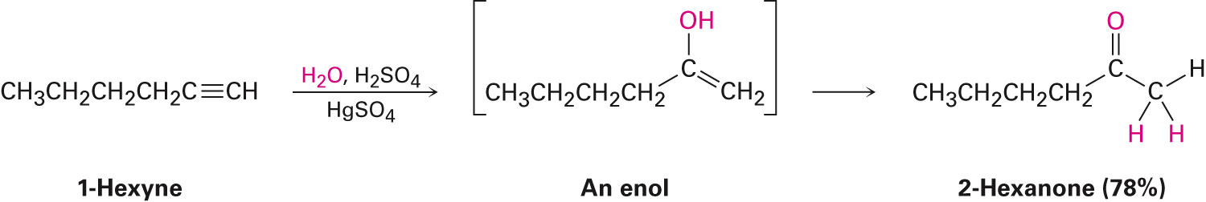
Hydration of Alkynes
Mercury (II)-catalyzed hydration of alkynes
Alkynes undergo hydration readily in the presence of mercury (II) sulfate as a Lewis acid catalyst
Reaction occurs with Markovnikov chemistry
Enol intermediate rearranges into a ketone through the process of keto–enol tautomerism
Notes:
Hydration of alkynes

Slide 19
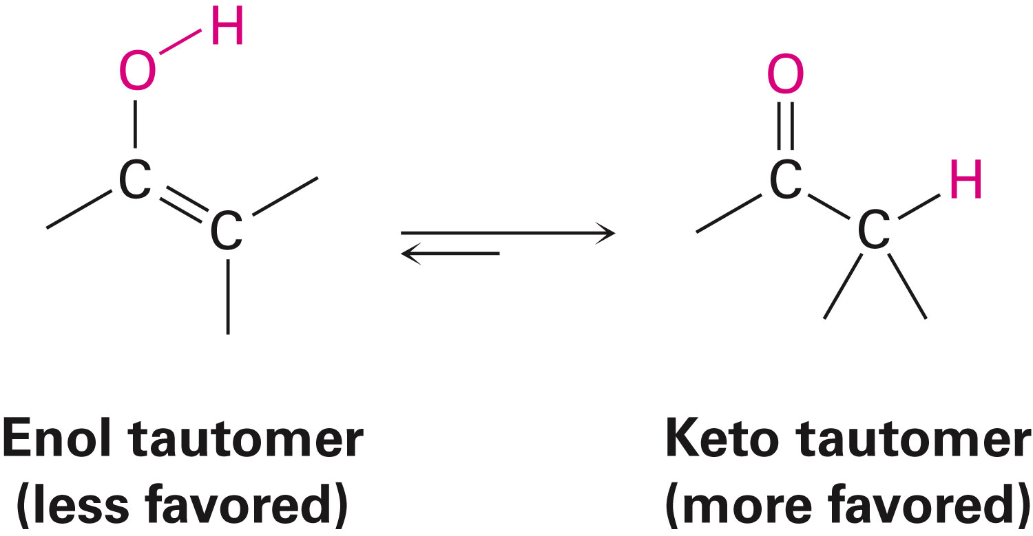
Keto-Enol Tautomerism
Enols rearrange to the isomeric ketone by the rapid transfer of a proton from the hydroxyl to the alkene carbon
Isomeric compounds that can rapidly interconvert by the movement of a proton are called tautomers
Notes:
Hydration of alkynes

Slide 20
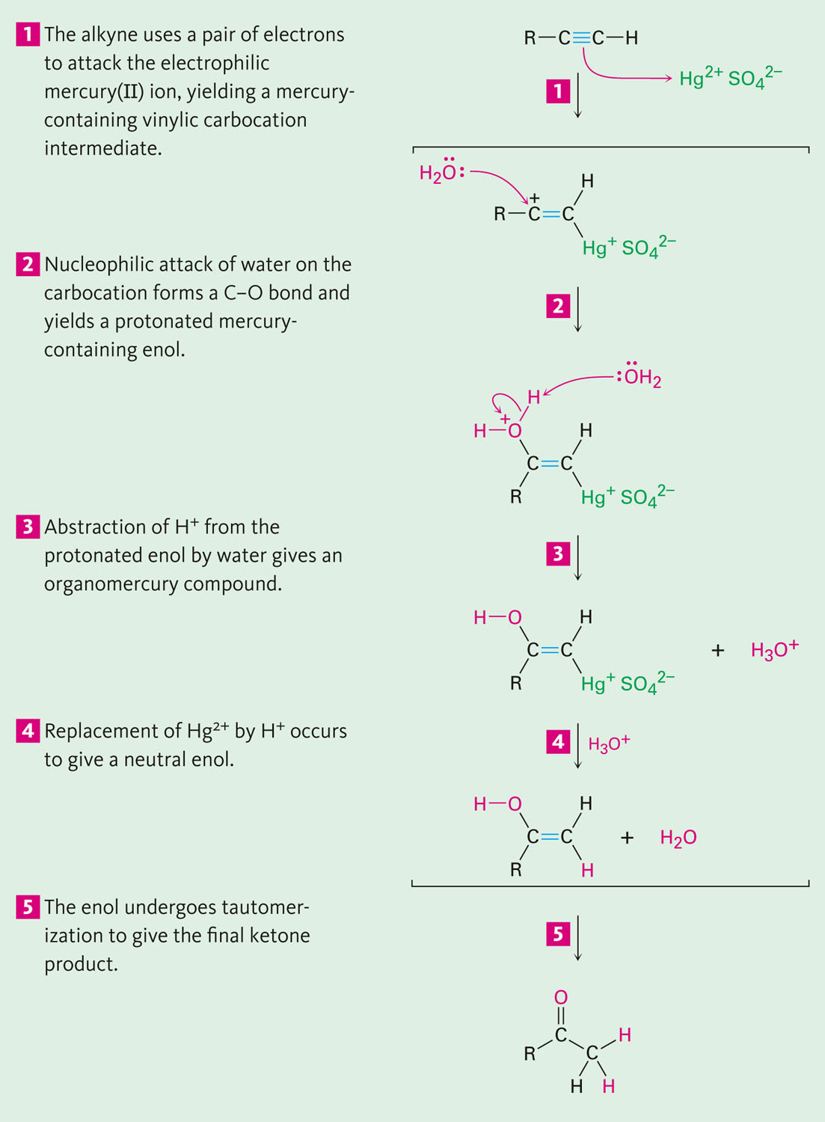
Figure 9.3 - Mechanism of Mercury (II)-Catalyzed Hydration of Alkyne to Yield a Ketone
Notes:
Hydration of alkynes

Slide 21
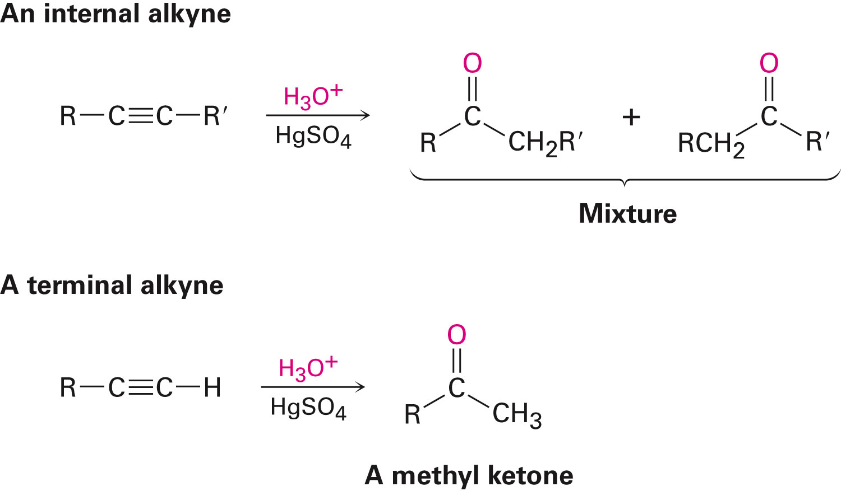
Hydration of Unsymmetrical Alkynes
Hydration of an unsymmetrically substituted internal alkyne (RC≡CR’) results in a mixture of both possible ketones
Notes:
Hydration of alkynes

Slide 22

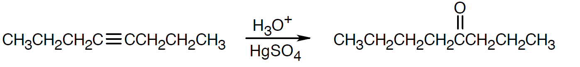
Worked Examples
What products are obtained by hydration of:
Solution:
This symmetrical alkyne yields one product
Notes:
Hydration of alkynes

Slide 23
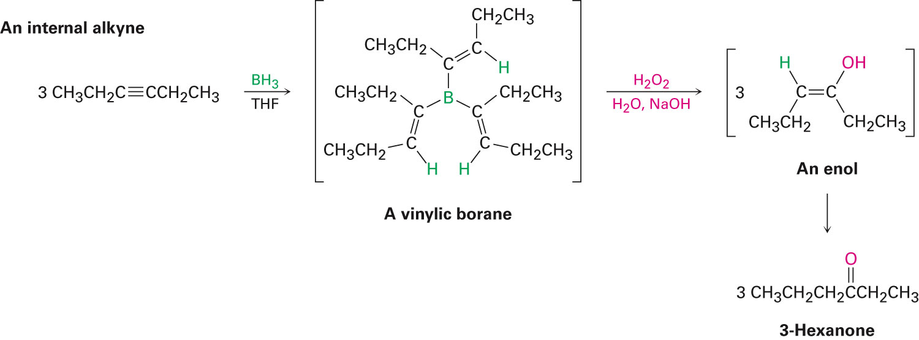
Hydroboration-Oxidation of Alkynes
Borane adds to alkynes to give a vinylic borane
Oxidation with H₂O₂ produces an enol that converts to the ketone or aldehyde by tautomerization
Notes:
Hydration of alkynes

Slide 24
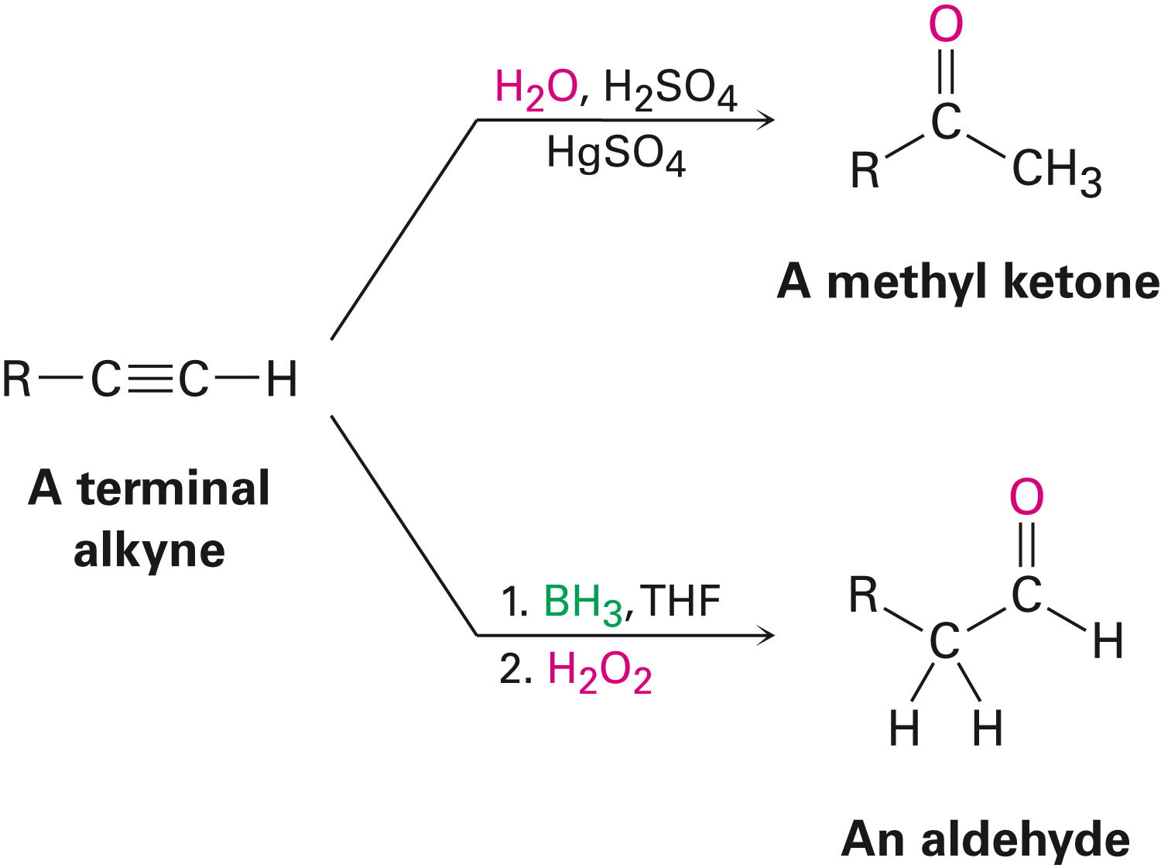
Comparison of Hydration of Terminal Alkynes
Product from the mercury(II)-catalyzed hydration converts terminal alkynes to methyl ketones
Notes:
Hydration of alkynes

Slide 25
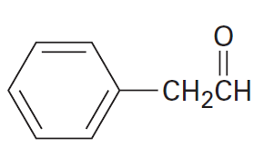
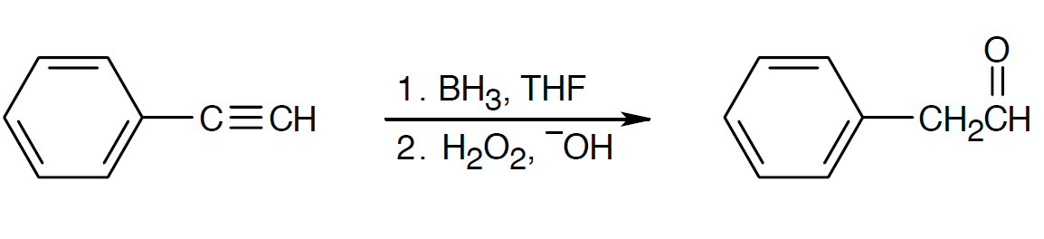
Worked Examples
Name an alkyne that can be used in the preparation of the following compound by a hydroboration-oxidation reaction
Solution:
Notes:
Hydration of alkynes

Slide 26
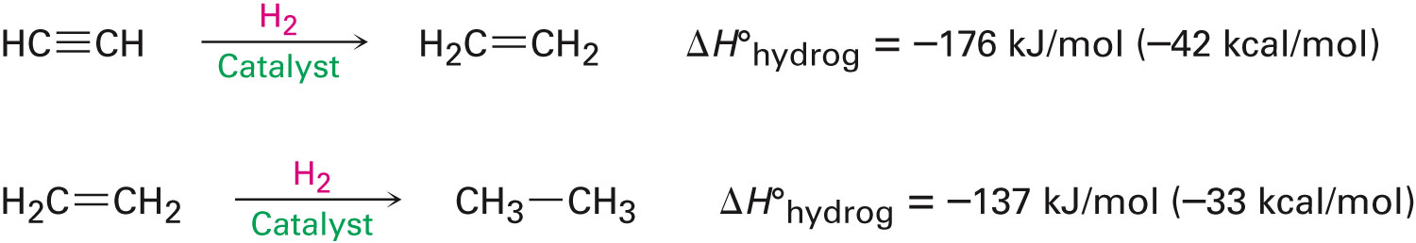
Reduction of Alkynes
Accomplished by addition of H₂ over a metal catalyst
Is a two-step reaction using an alkene intermediate
Notes:
Reduction of alkynes

Slide 27
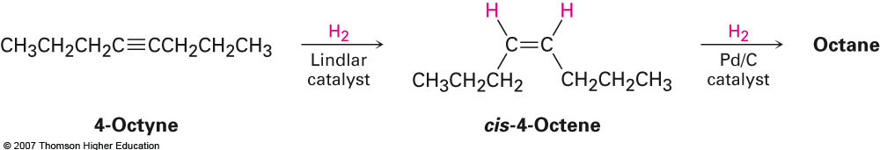
Reduction of Alkynes
Addition of H₂ using deactivated palladium on carbon as a catalyst (the Lindlar catalyst) produces a cis alkene
Notes:
Reduction of alkynes

Slide 28
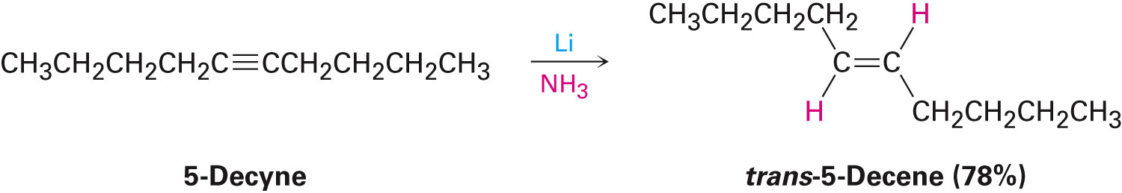
Reduction of Alkynes
Alkynes can also be converted to alkenes using sodium or lithium metal as the reducing agent in liquid ammonia as the solvent
This method produces trans alkenes
Notes:
Reduction of alkynes

Slide 29
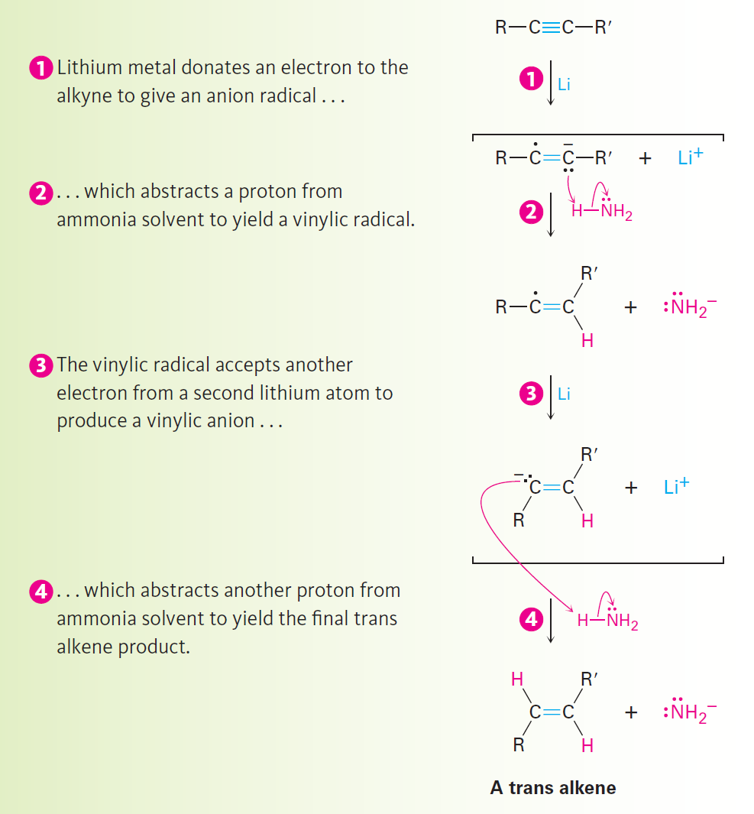
Figure 9.4 - Mechanism of Li/NH₃ Reduction of an Alkyne
Notes:
Reduction of alkynes

Slide 30
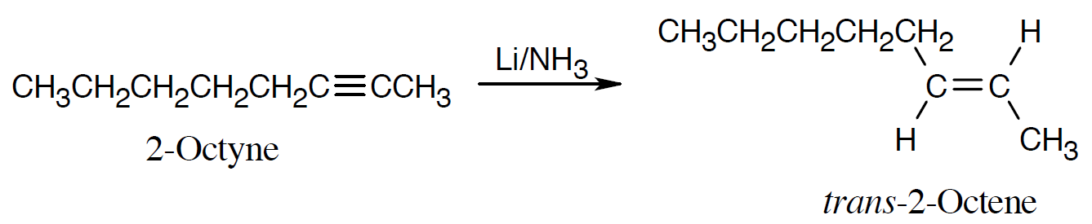
Worked Example
Use any alkyne to prepare trans-2-Octene
Solution:
Using the correct reducing agent results in a double bond with the desired geometry
Notes:
Reduction of alkynes

Slide 31
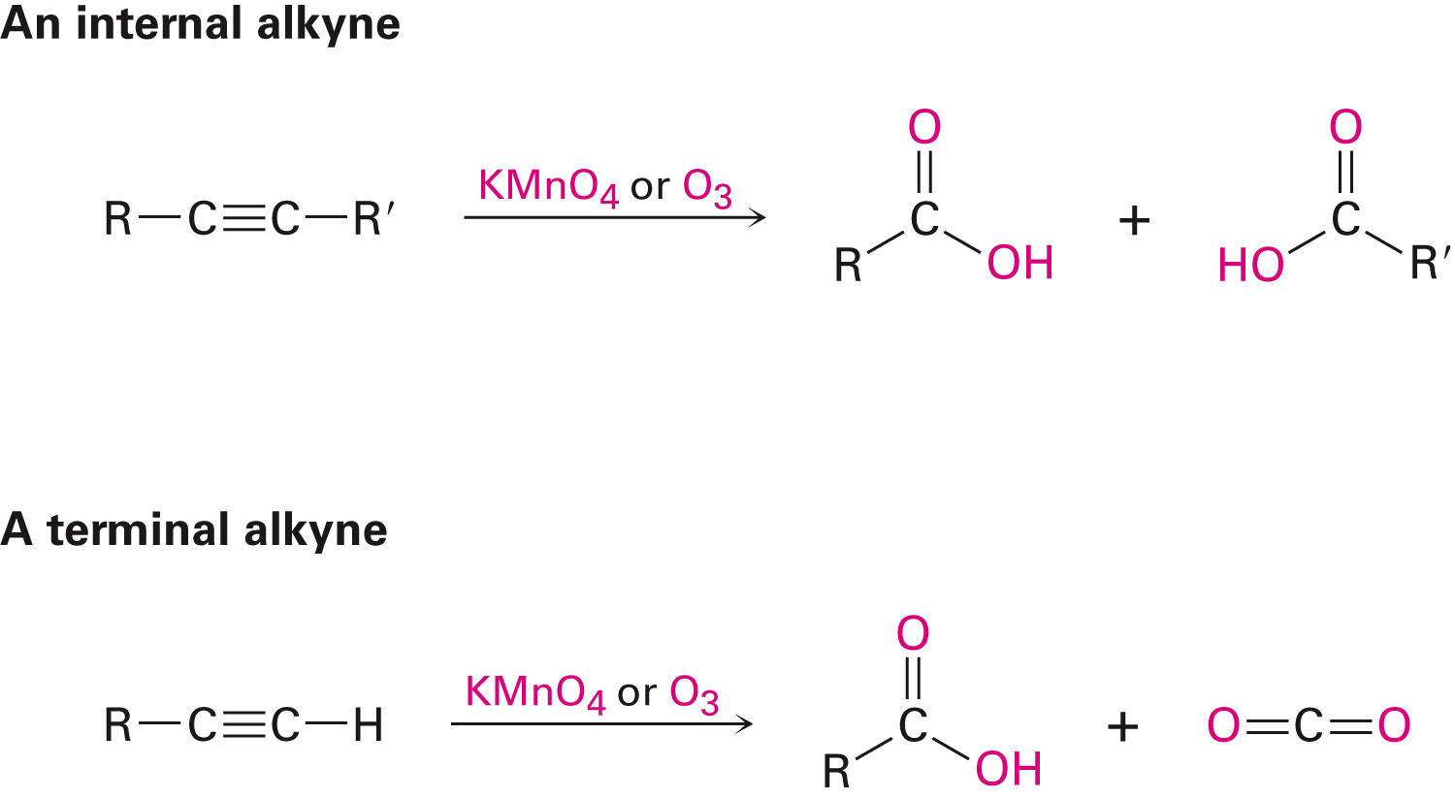
Oxidative Cleavage of Alkynes
Strong oxidizing reagents (O₃ or KMnO₄) cleave internal alkynes, producing two carboxylic acids
Carboxylic acids are formed from the cleavage of an internal alkyne
CO₂ is one of the products formed by cleavage of a terminal alkyne
Notes:
Oxidative cleavage of alkynes

Slide 32
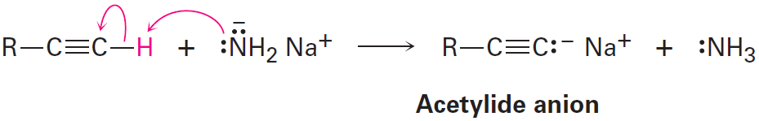
Alkyne Acidity: Formation of Acetylide Anions
Reaction of a strong base with a terminal alkyne results in the removal of the terminal hydrogen and the formation of an acetylide anion
Notes:
Alkyne acidity: Formation of acetylide anions

Slide 33
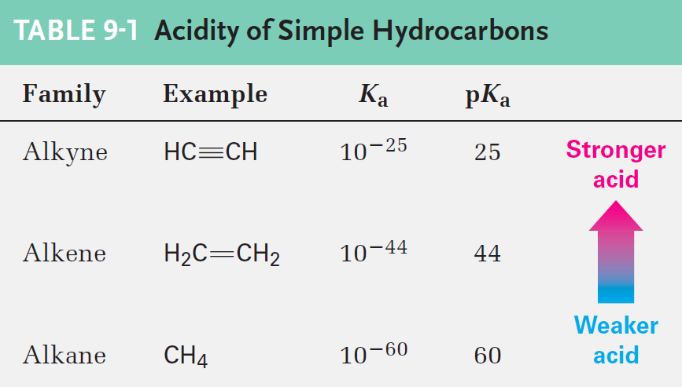
Acidity of Hydrocarbons
Methane and ethylene do not react with a common base
Acetylene can be deprotonated by the conjugated base of any acid with a pK_{a} higher than 25%
Notes:
Alkyne acidity: Formation of acetylide anions

Slide 34
Acidity is Based on the Percentage of s Character
Percentage of “s character” is based on the sp-hybridized carbon atom
Acetylide anions possess an sp-hybridized carbon with 50% s character
Vinylic anions have an sp²-hybridized carbon with 33% s character
Alkyl anions have an sp³-hybridized carbon with 25% s character
Notes:
Alkyne acidity: Formation of acetylide anions

Slide 35
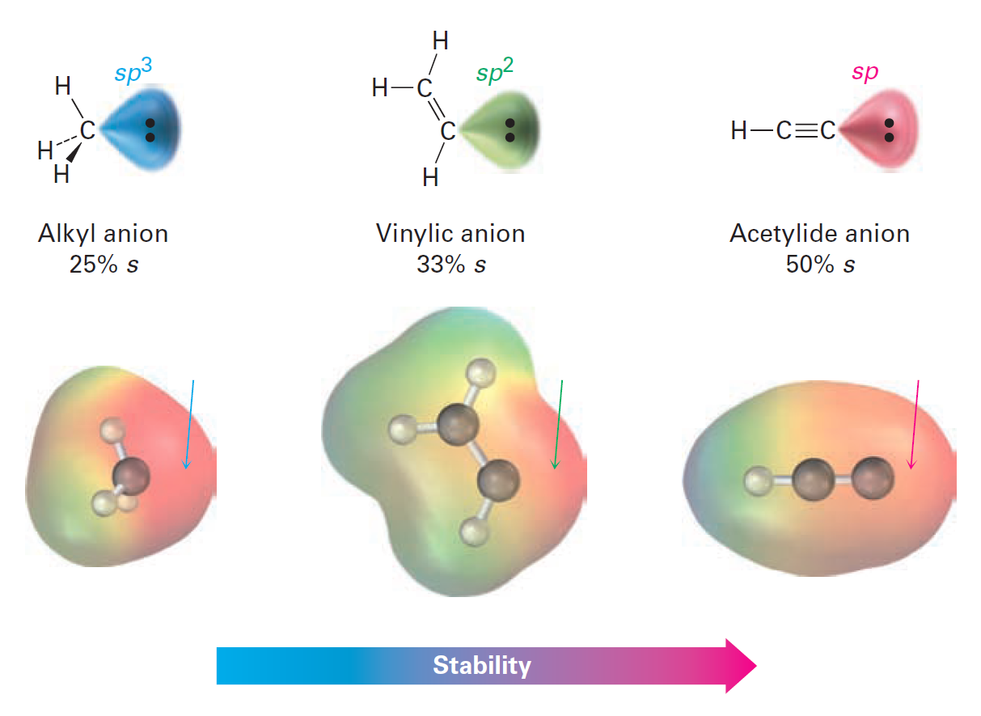
Figure 9.5 - Comparison of Alkyl, Vinylic, and Acetylide Anions
Notes:
Alkyne acidity: Formation of acetylide anions

Slide 36
Worked Example
The pK_{a} of acetone, CH₃COCH₃, is 19.3
Which of the following bases is strong enough to deprotonate acetone?
A) KOH (pK_{a} of H₂O = 15.7)
B) Na⁺ ⁻C≡CH (pK_{a} of C₂H₂ = 25)
C) NaHCO₃ (pK_{a} of H₂CO₃ = 64)
D) NaOCH₃ (pK_{a} of CH₃OH = 15.6)
Solution:
Na⁺ ⁻C≡CH adequately deprotonates acetone
Notes:
Alkyne acidity: Formation of acetylide anions

Slide 37
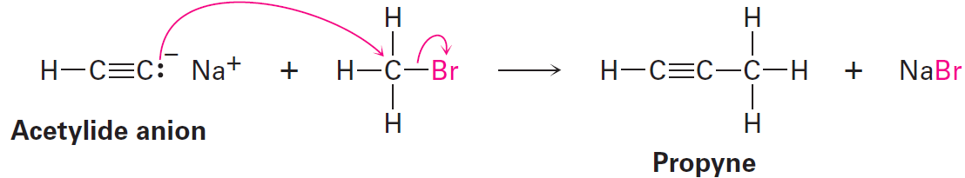
Alkylation of Acetylide Anions
Acetylide anions are strongly nucleophilic due to the negative charge and unshared electron pair on carbon
Acetyl anions react with alkyl halides, yielding a new alkyne product
Notes:
Alkylation of acetylide anions

Slide 38
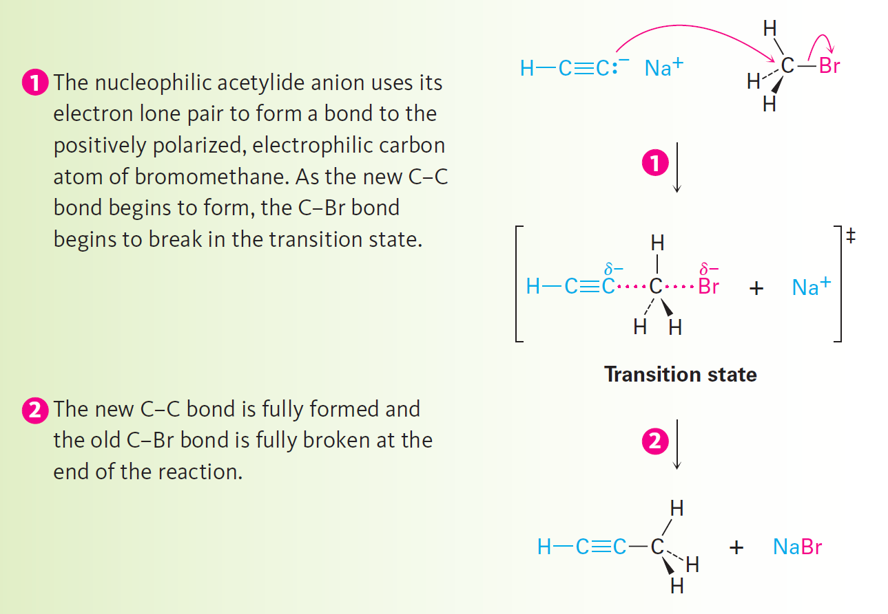
Figure 9.6 - Alkylation Reaction of Acetylide Anion
Notes:
Alkylation of acetylide anions

Slide 39
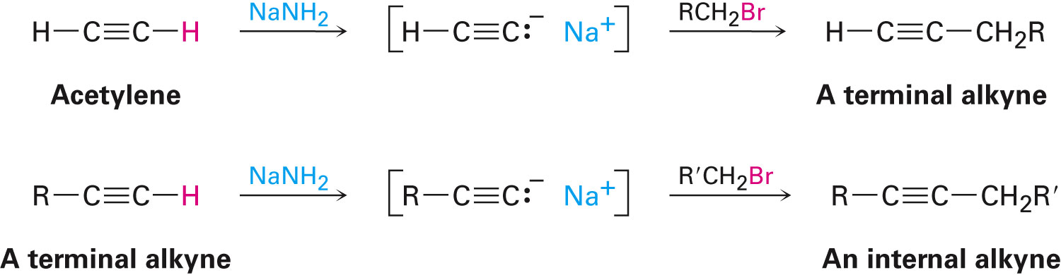
Alkylation of Acetylide Ions
Any terminal alkyne can be converted into its corresponding anion
Further interaction with an alkyl halide gives an internal alkyne product
Terminal alkynes can be prepared from an alkylation of acetylene
Notes:
Alkylation of acetylide anions

Slide 40
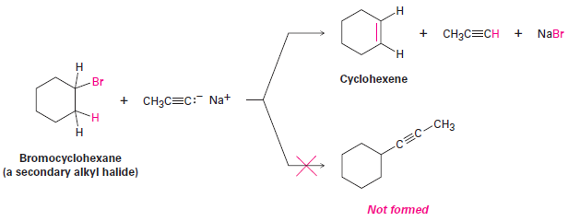
Alkylation of Acetylide Ions
Further alkylation of a terminal alkyne produces an internal alkyne
Acetylide ions cause elimination instead of substitution upon reaction with secondary and tertiary alkyl halides
Notes:
Alkylation of acetylide anions

Slide 41
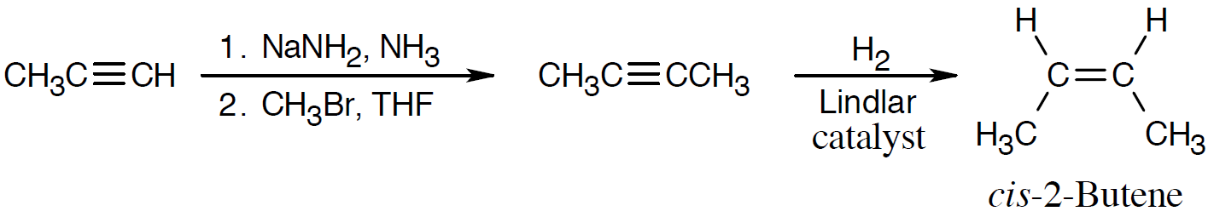
Worked Example
Prepare cis-2-butane using propyne, an alkyl halide
Use any other reagents needed
Solution:
Hydrogenation of an alkyne, which can be synthesized by alkylation of a terminal alkyne, forms a cis bond
Notes:
Alkylation of acetylide anions

Slide 42
Introduction to Organic Synthesis
Organic synthesis is vital to pharmaceutical industries, chemical industries, and academic laboratories
Planning a successful multistep synthetic sequence involves:
Utilizing available knowledge of chemical reactions
Organizing knowledge into a workable plan
Working in a retrosynthetic direction is important in planning an organic synthesis
Working backward
Notes:
An introduction to organic synthesis

Slide 43
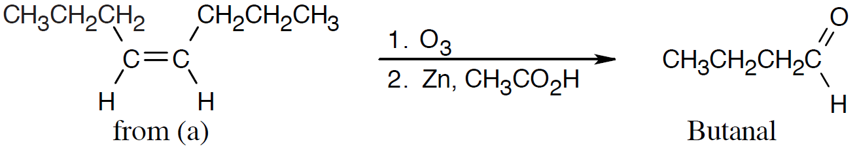
Worked Example
Use 4-Octane as the only source of carbon in the synthesis of Butanal
Use any inorganic compounds necessary
Solution:
Butanal can be synthesized from either cis-4-octene or trans-4-octene
Notes:
An introduction to organic synthesis

Slide 44
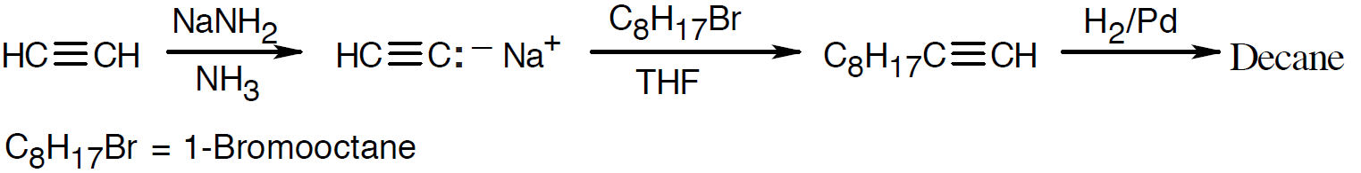
Worked Example
Synthesize decane using an alkyl and any alkyl halide needed
Solution:
Using retrosynthetic logic:
H₂/Pd can reduce decane to C₈H₁₇C≡CH
Alkalylation of HC≡C:⁻Na⁺ by C₈H₁₇Br, 1-bromooctane produces C₈H₁₇C≡CH
Treatment of HC≡CH with NaNH₂, NH₃ gives HC≡C:⁻Na⁺
Notes:
An introduction to organic synthesis

Slide 45
Summary
Alkenes are hydrocarbons comprising a carbon–carbon triple bond
Enols are formed when alkynes react with aqueous sulfuric acid in the presence of mercury (II) catalyst
Reduction of alkynes can produce alkanes and alkenes
Tautomerization is a process in which an enol yields a ketone

Slide 46
Summary
Acetylide anions are formed when a strong base is removed by alkyne hydrogen
In an alkylation reaction, an acetylide anion acts as a nucleophile and displaces a halide ion from a primary alkyl halide

